Slide 1
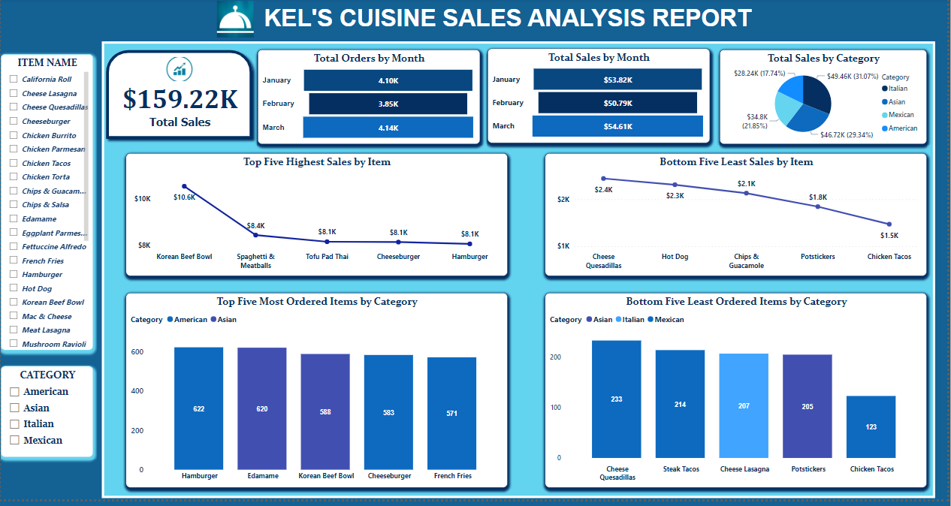

Slide 2
TABLE OF CONTENTS
INTRODUCTION – Brief introduction about the project
DATA CLEANING – Brief description of the data preparation process
DATA INSIGHTS – Description about the analysis of the data

Slide 3

KEL’S CUISINE SALES DATA
DATA SOURCE LINK:
https://drive.google.com/drive/folders/1HZKvsZdShfG6SSVM0QYg8O6NycaYdNvc?usp=drive_link

Slide 4

01.
INTRODUCTION
Brief introduction about the project.

Slide 5
COMPANY OVERVIEW
Kel’s Cuisine is a restaurant which serves international cuisines. They sell delicacies based on different categories. Their various categories in which they serve cuisines are:
American, Asian, Italian, Mexican.

Slide 6
PROJECT AIM
To give insights on :
The overall performance of the restaurant.
Which cuisine needs more attention.
What cuisine needs to be developed to make more profit.

Slide 7
DATASET DESCRIPTION
The dataset contains:
Total columns : 9
Total rows : 12,266
Missing values: 172

Slide 8
02.
DATA CLEANING
Brief description of the data preparation process.

Slide 9
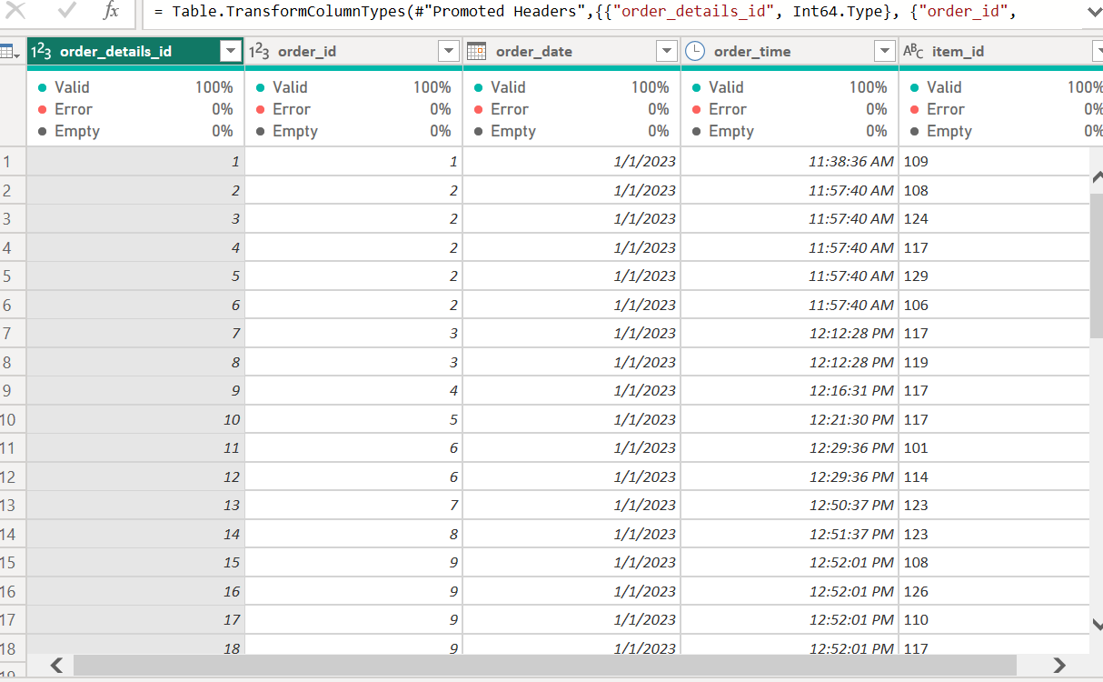
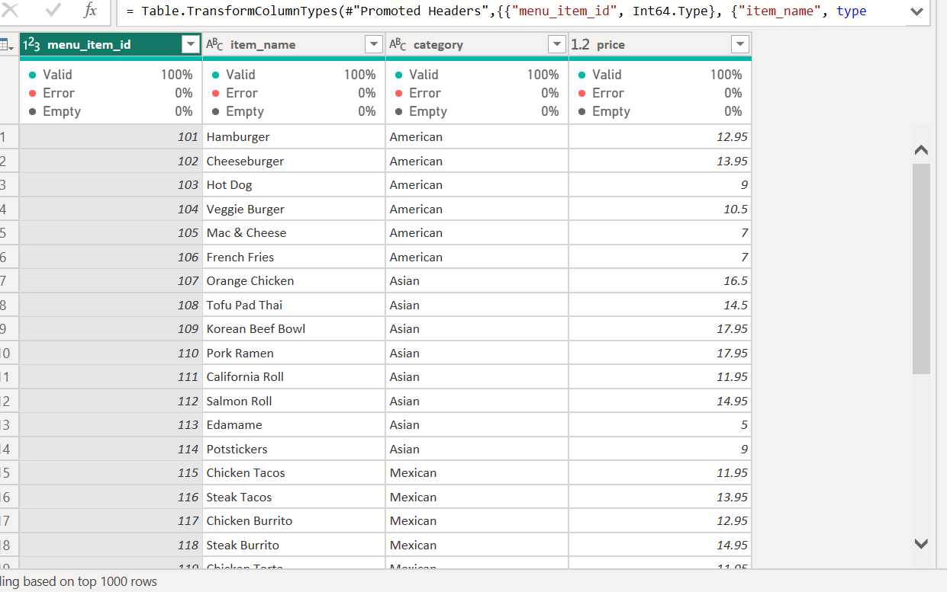
RAW DATASET

Slide 10
DATA CLEANING PROCESS
Missing values were removed.
Price, item_name, and category were merged from menu_id to order_id.
Date function query was created.
New measure; Total sales, was created.
AFTER CLEANING
COLUMNS = 12
ROWS = 12,129

Slide 11
03.
DATA INSIGHTS
KEL’S CUISINE SALES ANALYSIS
PRODUCT SALES ANALYSIS
MONTHLY SALES ANALYSIS

Slide 12
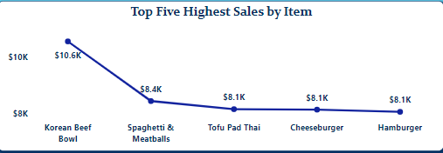
This data visualization shows the top five menu items that brought in the highest sales from the dataset given . Korean Beef Bowl brought in the highest sales of $10.6k . Since the Korean Beef Bowl is making high sales, it should be paid more attention to and it should be produced in more quantities to ensure more sales rolling in and other items on the visualization should be focused on.

Slide 13
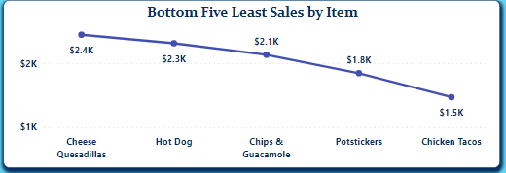
This data visualization shows the bottom five menu items that brought in the lowest sales from the dataset given . Chicken Tacos brought in the lowest sales of $1.5k . Items on the menu with low sales should be least produced or not produced anymore to prevent wastage and the cost used in producing those items could be used better in the items bringing in more sales.

Slide 14
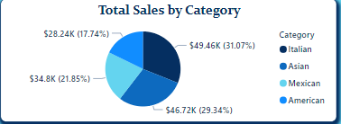
This data visualization shows the total sales of items by category which shows the total sales of items in American Category has the lowest of $28.24k taking, 17.74% of total sales by category, while total sales of items in Italian Category has the highest of $49.46k, taking 31.07% of total sales by category.

Slide 15
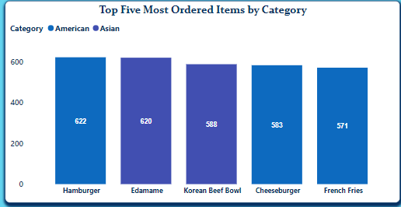
This data visualization shows the top five most ordered items by category from the dataset given. Hamburger has the highest number of orders having 622 orders which is in the American Category. The items having large orders should be focused more on since they are the items people are ordering more.

Slide 16
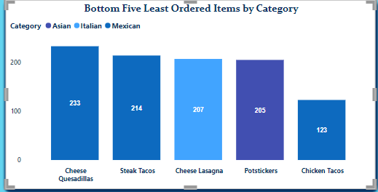
This data visualization shows the least five least ordered items by category from the dataset given. Chicken Tacos has the least number of orders having 123 orders which is in the Mexican Category. The items having low orders should be removed or less produced in order to put the cost in producing those items in the items producing more orders.

Slide 17
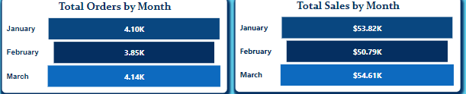
This data visualization shows the MONTHLY ANALYSIS of Kel’s Cuisine. The highest total orders is in the month of March having 4.14k orders while the least total orders is in the month of February having 3.85k orders. The highest total sales is in the month of March having the total sum of $54.61k sales while the least total sales is in the month of February having the total sum of $50.79k sales.

Slide 18
KEL’S CUISINE DATA DASHBOARD
DATA VISUALIZATION DASHBOARD LINK:
https://app.powerbi.com/view?r=eyJrIjoiZjE3ZGI5MGYtMDcyYy00NGNhLWI5YzAtOWNkNmFjMWFlMGQyIiwidCI6ImMwNjAzYjY0LTYyYTYtNDkyMy05YzU0LTkzMjFjM2YyMWVjNyJ9

